Slide 1
“A Predictive-Text Interface for BCIs”
Student: Franciszek Mierzejewski (MIERZ75605)
Supervisor: Dr Ian Daly

Slide 2
Unassisted P300 Spellers Fall 70% Below Subjects With ALS Demands
DEMAND
15-19 Characters/Minute Required
Survey of 61 ALS patients (Huggins et al., 2011) showed 72% require >= 15-19 letters/minute with >= 90% accuracy for daily independence.
REALITY
2.0 – 5.0 Characters/Minute Achieved
74% Shortfall
Physiological Ceiling: Classifiers require 15 to 30 seconds of repetitive stimulus intensification per character to average out background noise.
Cognitive Exhaustion: Typing a 50-word email at 3.5 characters/minute requires 1h 11minutes of sustained, intense visual fixation – causing significant mental fatigue, eye strain and loss of attention.
Solution Space: By integrating context-aware predictive language modelling, we can eliminate character selections and accelerate communication.

Slide 3
P300 Foundations Establish Feasability but Suffer Severe Interaction Bottlenecks
Farwell & Donchin (1988)
System Design: 6x6 matrix, flashing col/row randomnly at 125/500ms ISI.
Rare, attended target cell elicits positive P300 potential.
Achieved 2.3 char/min at 95% accuracy
Limitation: Single Pz electrode, with 4 healthy young individuals as cohort. No language constraints.
Wolpaw (2007)
User adapts brain patterns, algorithm adapts decoding – mutual adaption.
BCI2000 standardised home system with simplified 16 channel electrode cap.
Locked-In ALS patient used system (configurable) independently for 6-8h daily for email.
Sequential menu creates latency on selection menu. Shortcuts required.
Rezeika et al. (2018)
69 BCI speller studies analysed.
P300 = 65%
SSVEP = 23%
Motor Imagery = 6%
Hybrid = 6%
14.5% of surveyed studies used any form of word prediction, front-end language interface remains an area under-researched.

Slide 4
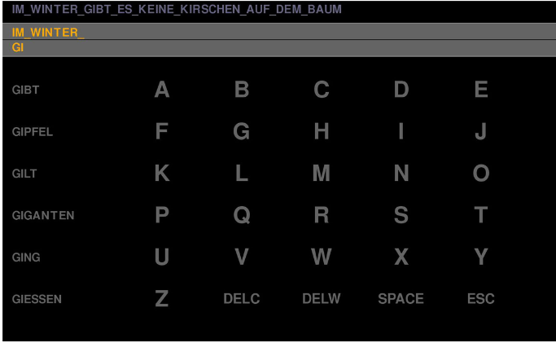
Naïve Prediction
c
Ryan et al. (2011) – Separate Window
24 healthy subjects copy-spelled a 58-character sentence comparing non-predictive vs predictive with Quillsoft WordQ2.
Predictive typing faster (12.4min vs 20.2min) and raised output characters per min (5.28 vs 3.76 char/min)
Selection accuracy dropped from 89.8% to 84.9% with P300 significantly attenuated. Dual task inference from shifting gaze between matrix and adjacent prediction window. Extremely prone to time loss with errors.
c
Kauffman et al. (2012) – In Matrix
Embedded up to 6 dynamic word predictions directly into an 8x8 visual speller matrix.
Reduced time to spell a 36-character sentence by 42% across 20 participants with minimal loss in accuracy.
Therefore, to remove divided visual attention, spatial co-location should be adopted.
The study used unweighted static dictionary lists without context-aware n-gram priors.
Interaction Assertiveness (Quinn & Zhai, 2016)
In touchscreen typing, the study showed that ‘Extraverted’ suggestions (predictions always visible) reduced visible taps but slow down overall typing (2.66 char/s vs 3.09 for introverted) because visual scanning and verification overhead exceeds the time saved by tapping a prediction (~200ms). In a BCI, selecting a single character takes 15-30s, so predictions have more value, however they should be confidence gated.

Slide 5
Modern LLMs reach 95% of their theoretical bounds
LLM Ceiling (Parthsarathy et al. 2026)
Evaluated autoregressive LLMs of varying parameter complexity on EEG from 78 subjects transcribing 7,892 characters.
75.36 bits/min – Achieved by GPT-J, within 5% of theoretical word level oracle bound of 78.21.
Operates at 73% of human physiological timing ceiling of 103 bits/min.
Cross-subject decoding without user calibration achieved 59.90 bits/min
Increasing LLM parameter scale yields minimal bit-rate gains (<5%), which does not justify the increase in latency. Hence, the bottleneck is not language model scaling but HCI and error control.
Language Model Priors (Speier et al., 2012)
Replaced uniform priors with character trigrams
Flash sequences continued only until cumulative confidence exceeded threshold of 95%
Accuracy increased from 82.97% to 92.59%, bit rate from 22.06 bits/min to 33.15.
Used C-PAK for understanding abbreviations. Fallbacks KeywordAE to add keyword and FillMask to replace incorrect word.
Although there was no error-cost awareness involved, and the study was investigating eye-gaze typing speed, the techniques used are still applicable.

Slide 6
New Contribution I - Assertiveness
Using a combination of decoder signal certainty, and language-model entropy, we can apply 3 states of assertiveness to choose word predictions to improve Output Characters per Minute.
Introverted – High entropy/Noise, no point wasting cognitive energy/computation on predictions.
Ambiverted – 3 candidate predictions displayed in-matrix
Extraverted – With a high confidence, dedicated, high-salience cell in the matrix is displayed with the prediction.

Slide 7
New Contribution II – Expected Cost Minimisation
Currently, assisted P300 spellers rank candidate words by language-model probability.
Instead, I propose a system that ranks candidate predictions by expected interaction cost, considering the likelihood of each intended word, the effort saved by a correct prediction, and the cost of correcting an incorrect one. Hence, it recommends predictions that minimise expected communication effort than when compared to character-by-character typing.
It should be noted however that this approach must not favour short/generic words that are cheaper to enter. The system should optimise for effort required to communicate intended message, and not the suggested word alone.

Slide 8
New Contribution III – Entropy-Driven
Flashing all rows and columns equally is inefficient, it wastes time flashing letters that have minimal chance of being correct based on preceding context. On the other hand, flashing likely letters more frequently causes said letters to no longer be rare. The subject’s brain gets used to this, the P300 amplitude drops and the signal-to-noise ratio falls to the point that the classifier cannot detect the target.
Instead, I propose a system that continues to present stimuli in a pseudo-random order to preserve oddball rarity, but after each intensification calculates confidence given preceding context. After a certain confidence threshold is reached, such as 0.95 is reached, the flashes stop. Rows or columns that contain impossible letters are hence deprioritised.

Slide 9
Benchmarking
BASELINE (Farwell & Donchin)
Unassisted P300 speller
Classic 6x6 matrix.
Uniform priors across all targets.
Static 10 trial flashing per character.
CURRENT (Kaufmann et al.)
8x8 matrix with predictions in-matrix.
Trigram language model with maximum likelihood ranking.
Extraverted Assertiveness.
PROPOSED
In-matrix grid with commands such as UNDO (size of matrix TBD).
Tri-state confidence gating.
Expected cost minimisation word ranking.
Dynamic stopping.
*Using metrics ‘Output Characters per Minute’, ‘Mutual Information’, and ‘Keystroke Savings’

Slide 10
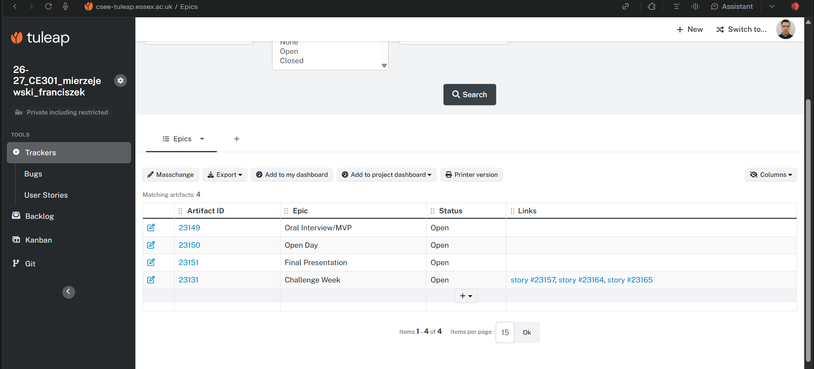
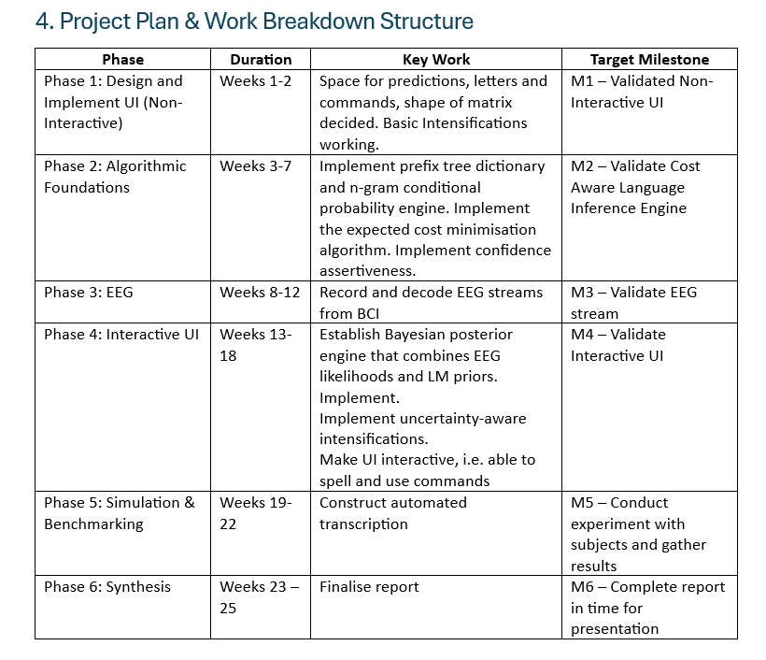
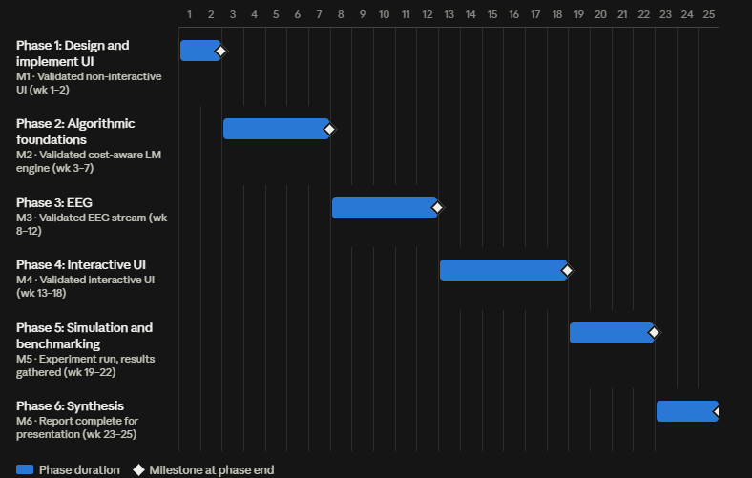
Structured Plan with Technical Milestones

Slide 11
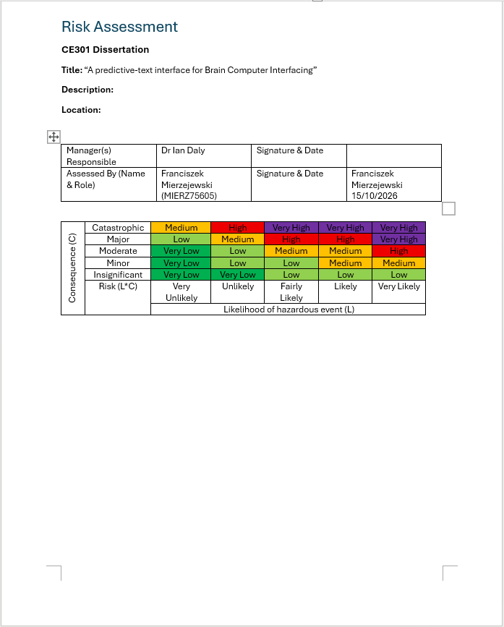
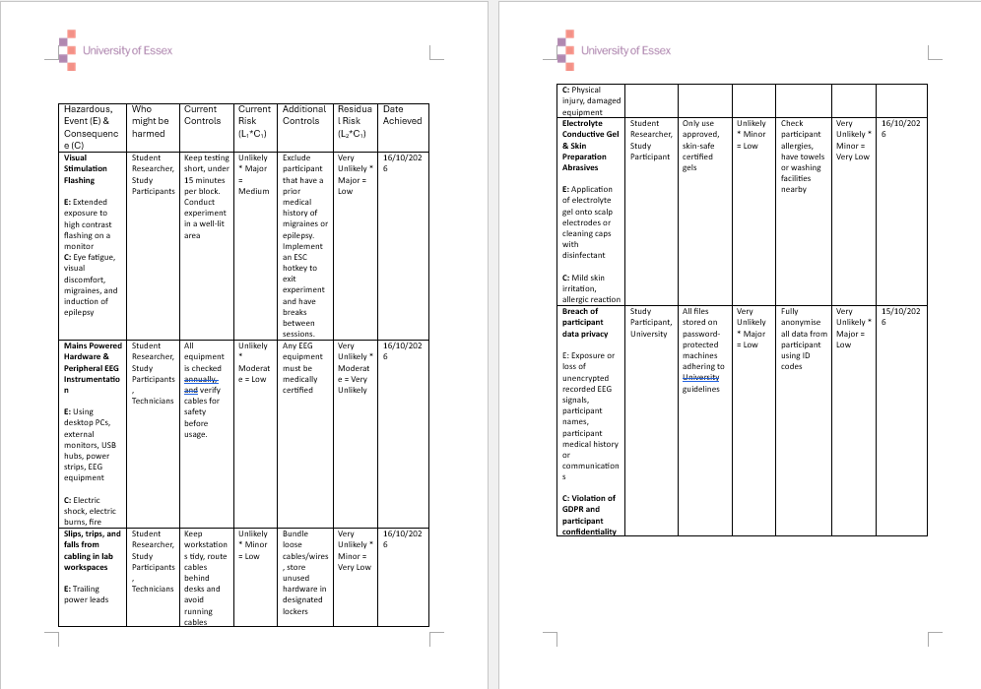
Risk Assessment

